Slide 1

Living room scamming
An application to counter scammers
Sem, Anouk, Randy, Angelo, Iris, Scott

Slide 2
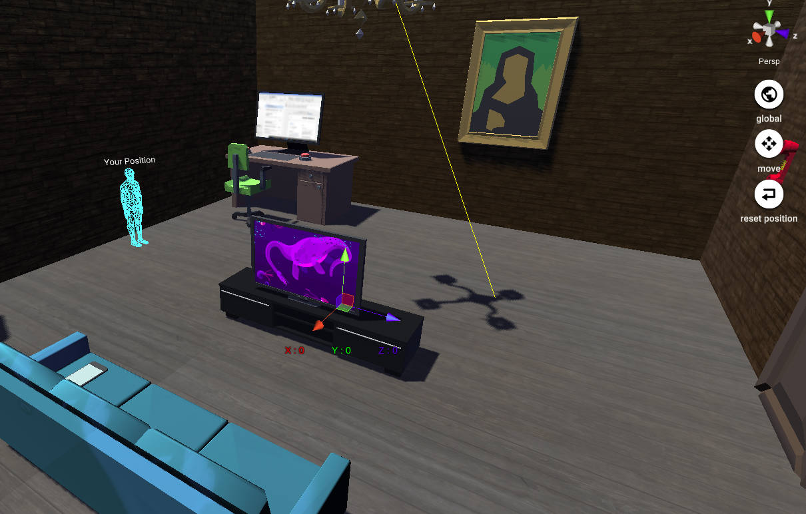

Slide 3
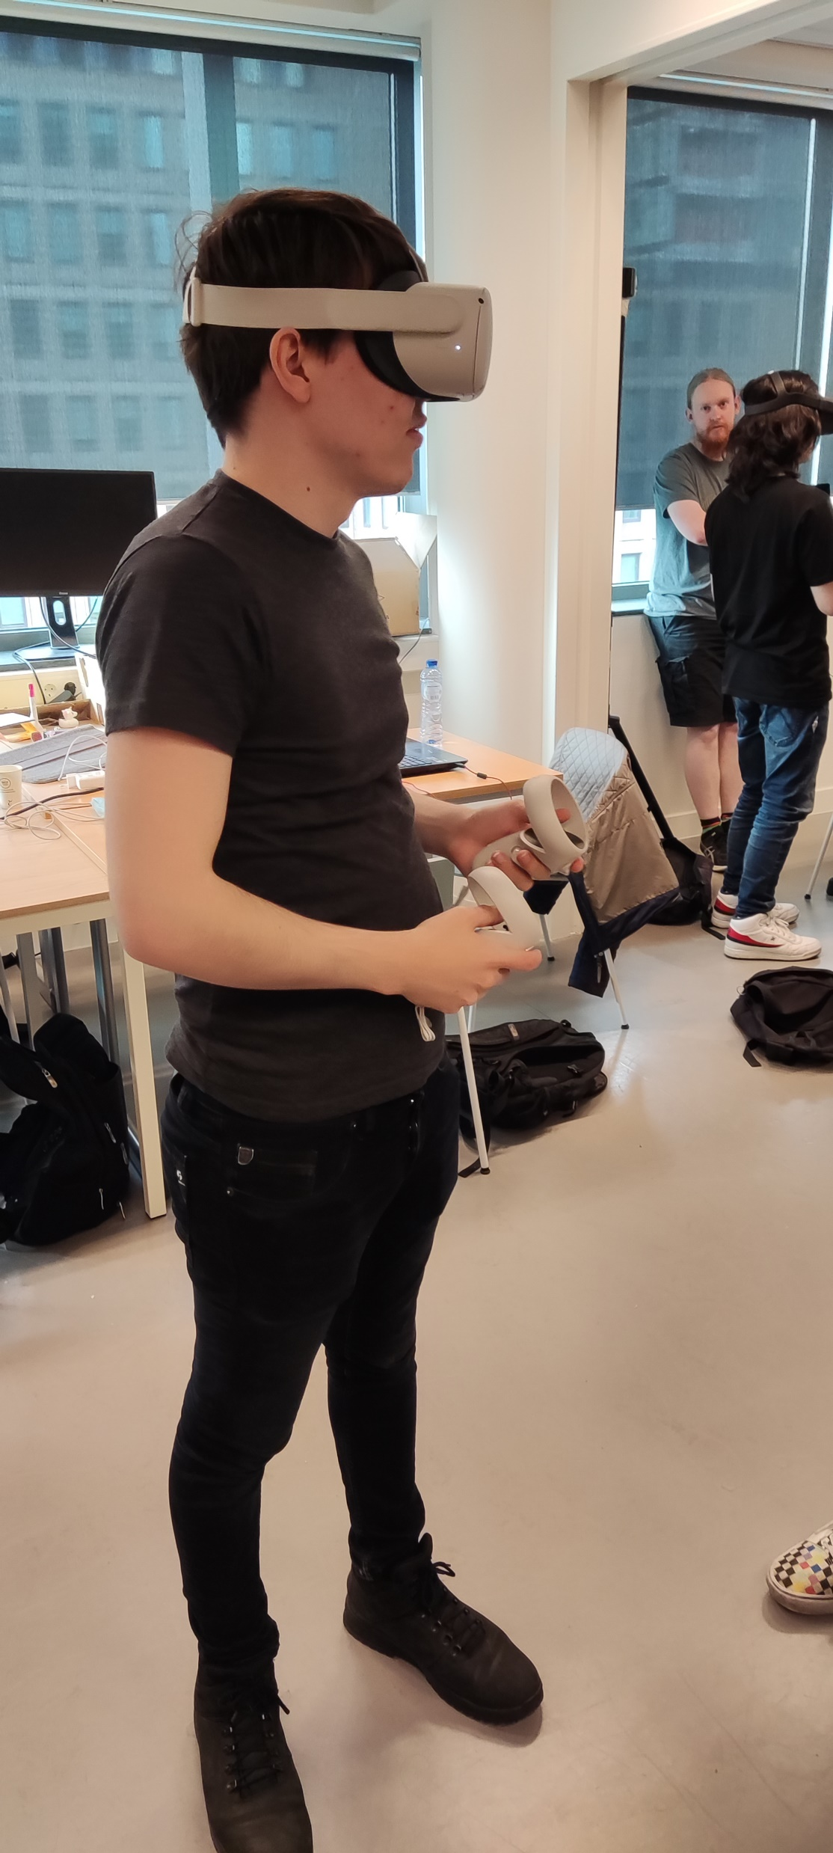
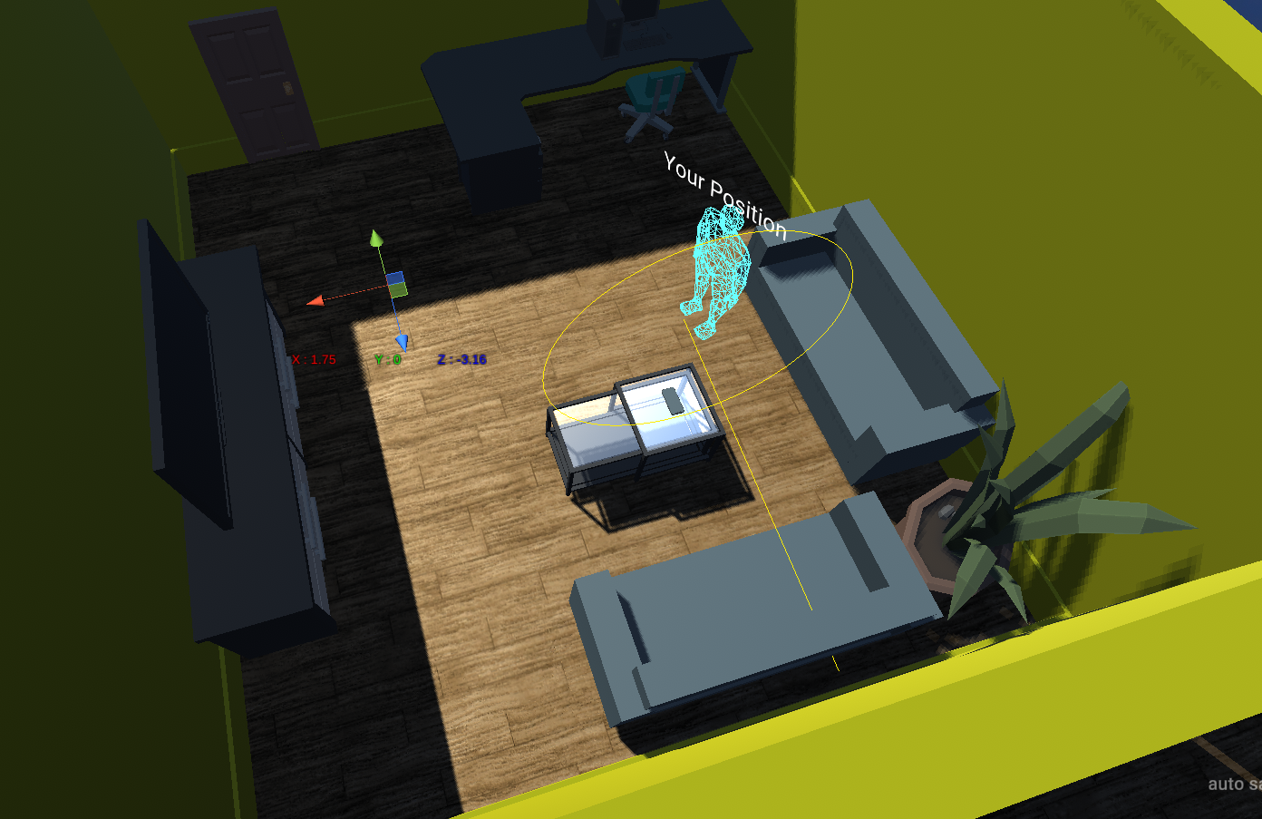
Wrong dimensions, easy to fix
You can’t see the pc screen clearly
Missing interactions with the phone and buttons
How would you like to interact: order pizza
                Slam on the button
Background noise of the video is distracting, not directional
Some interaction, like the tv or the door

